Slide 1
Deep Learning: Convolution Neural Networks
Shangsong Liang
Sun Yat-sen University
Originally produced by KH Wong

Slide 2
Introduction
Very Popular:
  Toolboxes: tensorflow, cuda-convnet and caffe (user friendlier)
A high performance Classifier (multi-class)
Successful in object recognition, handwritten optical character OCR recognition, image noise removal etc.
Easy to implementation
  Slow in learning
  Fast in classification

Slide 3
Overview
Prerequisite: Fully connected Back Propagation Neural Networks (BPNN), in
  http://www.cse.cuhk.edu.hk/~khwong/www2/cmsc5707/5707_08_neural_net.pptx
Convolution neural networks (CNN)

Slide 4
Architecture Overview
Regular Neural Networks
  Each neuron is connected to all neurons in the previous layer
  Do scale well to full images
Convolutional Neural Networks
  Layers of a Convnet have neurons arraged in 3 dimensions: width, height, depth

Slide 5
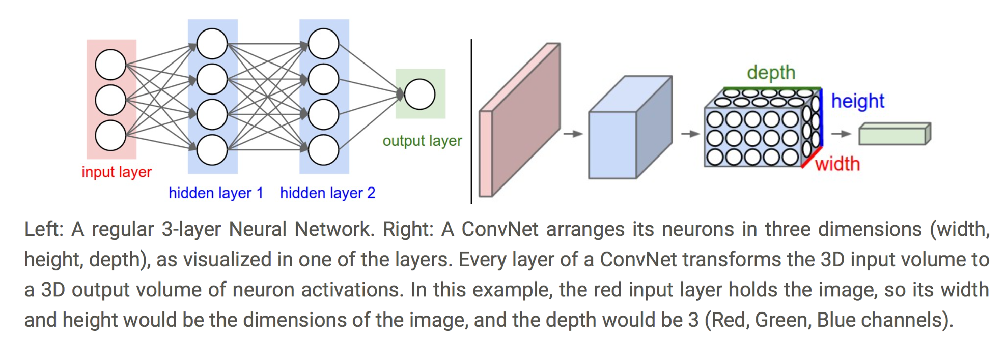
Architecture Overview

Slide 6
Example Architecture
INPUT [32x32x3] will hold the raw pixel values of the image, in this case an image of width 32, height 32, and with three color channels R,G,B.
CONV layer will compute the output of neurons that are connected to local regions in the input, each computing a dot product between their weights and a small region they are connected to in the input volume. This may result in volume such as [32x32x12] if we decided to use 12 filters.

Slide 7
Example Architecture
RELU layer will apply an elementwise activation function, such as the max(0,x) thresholding at zero. This leaves the size of the volume unchanged ([32x32x12]).
POOL layer will perform a downsampling operation along the spatial dimensions (width, height), resulting in volume such as [16x16x12].

Slide 8
Example Architecture
FC (i.e. fully-connected) layer will compute the class scores, resulting in volume of size [1x1x10], where each of the 10 numbers correspond to a class score, such as among the 10 categories of CIFAR-10. As with ordinary Neural Networks and as the name implies, each neuron in this layer will be connected to all the numbers in the previous volume.

Slide 9
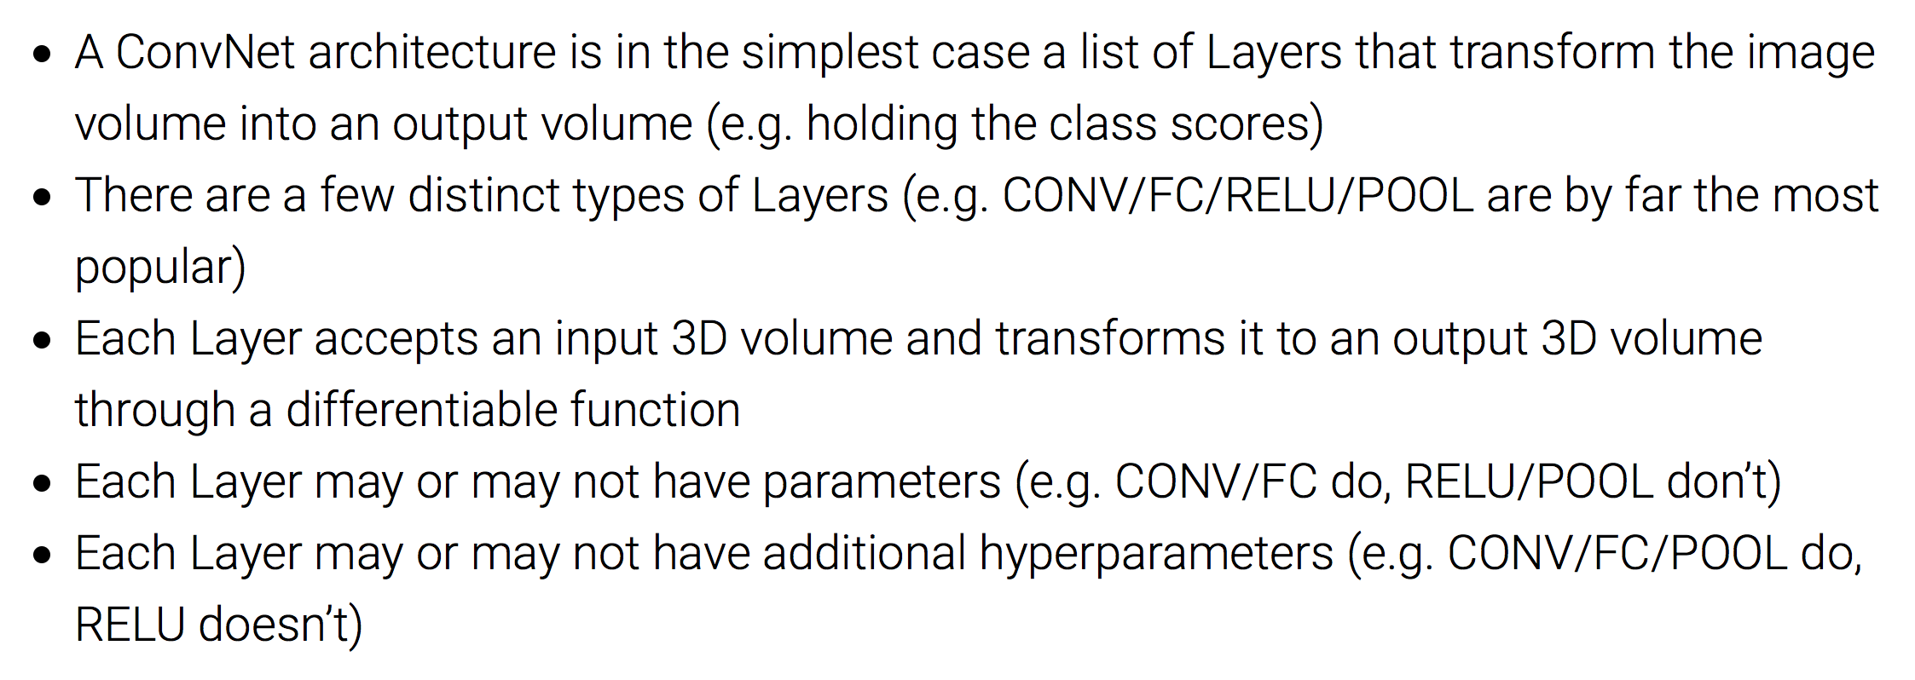
Summary of Example Architecture

Slide 10
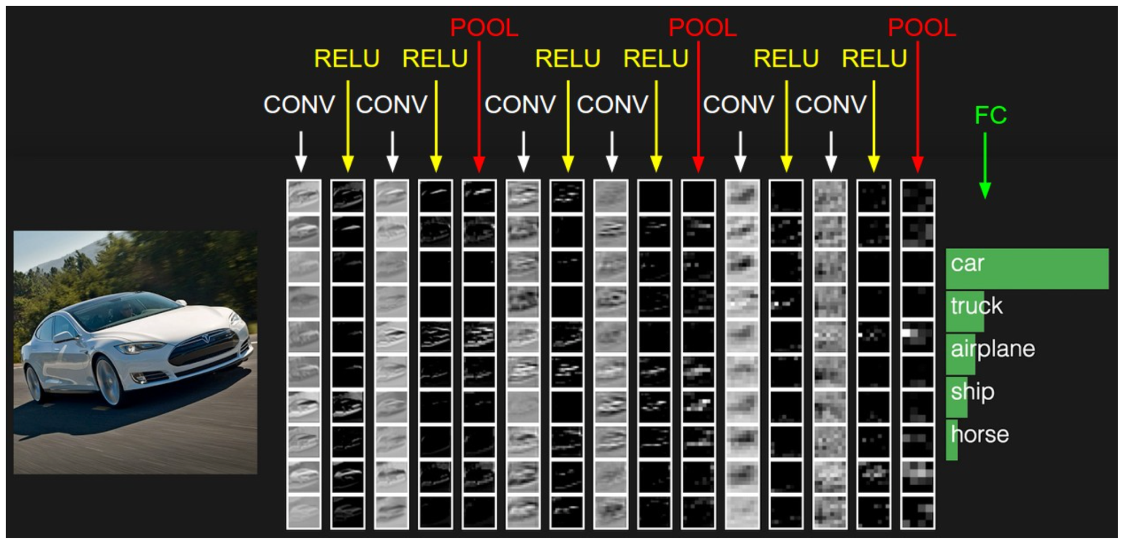
Example Architecture

Slide 11
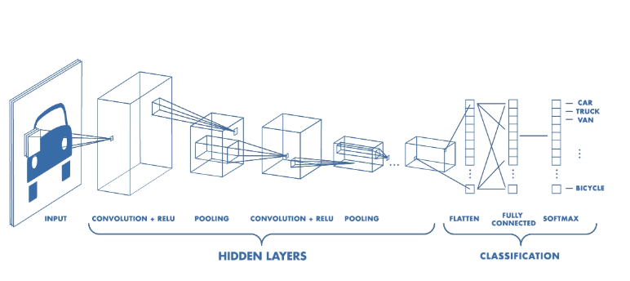
Architecture

Slide 12
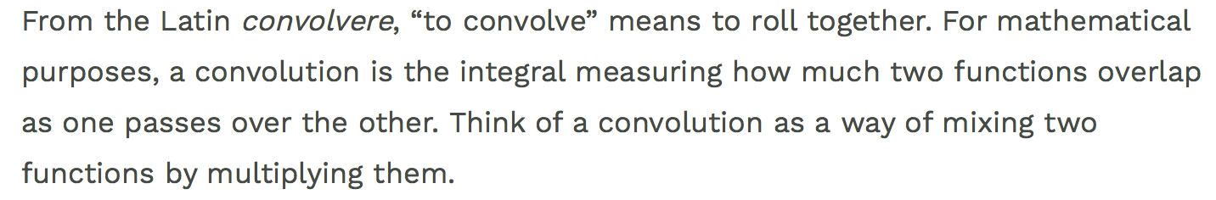
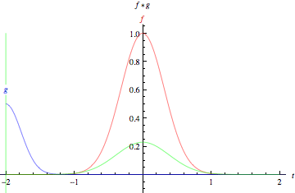
Convolutional Definition

Slide 13
Overview of
Convolution Neural Networks

Slide 14
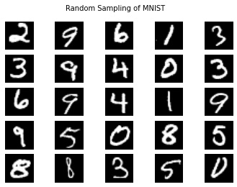
An example optical chartered recognition OCR
Example test_example_CNN.m in http://www.mathworks.com/matlabcentral/fileexchange/38310-deep-learning-toolbox
Based on a data base (mnist_uint8, from http://yann.lecun.com/exdb/mnist/)
60,000 training examples (28x28 pixels each)
10,000 testing samples (a different dataset)
  After training , given an unknown image, it will tell whether it is 0, or 1 ,..,9 etc.
  Recognition rate 11% use 1 epoch (training 200seconds)
  Recognition rate 1.2% use 100 epochs (hours of training)
http://andrew.gibiansky.com/blog/machine-learning/k-nearest-neighbors-simplest-machine-learning/

Slide 15
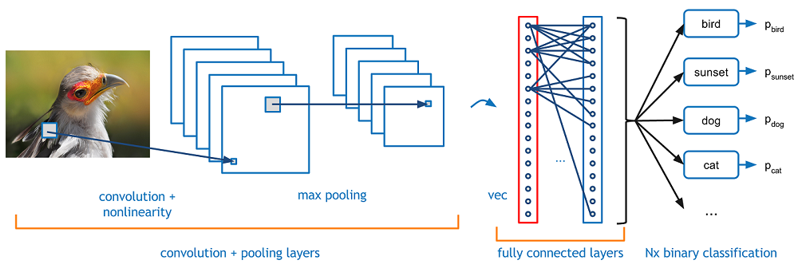
The basic idea of Convolution Neural Networks CNN
Same idea as Back-propagation-neural networks (BPNN) but different implementation
After vectorized (vec), the 2D arranged inputs become 1D vectors. Then the network is just like a BPNN
(Back propagation neural networks )
https://adeshpande3.github.io/adeshpande3.github.io/A-Beginner%27s-Guide-To-Understanding-Convolutional-Neural-Networks/

Slide 16
Basic structure of CNN
The convolution layer: see how to use convolution for feature identifier

Slide 17
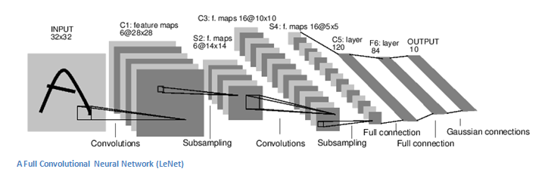
The basic structure
Input conv. subs. conv subs fully fully output
Alternating Convolution (conv) and subsampling layer (subs)
Subsampling allows the features to be flexibly positioned

Slide 18
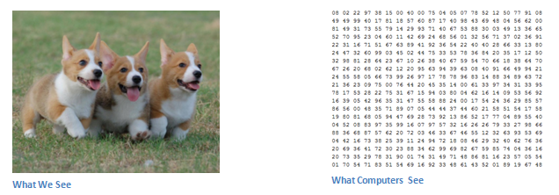
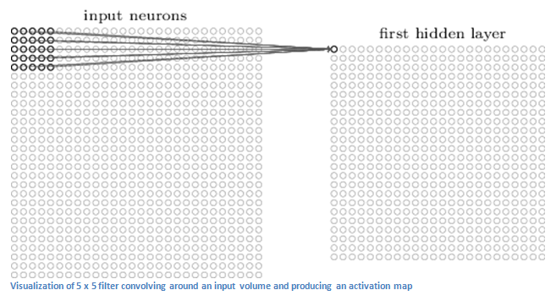
Convolution (conv) layer:
Example: From the input layer to the first hidden layer
The first hidden layer represents the filter outputs of a certain feature
So, what is a feature?
Answer is in the next slide

Slide 19
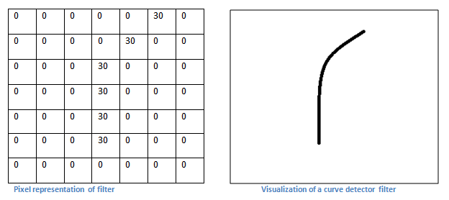
Convolution (conv) layer
Idea of a feature identifier
We would like to extract a curve (feature) from the image

Slide 20
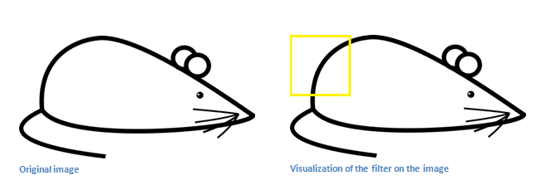
Convolution (conv) layer
The curve feature in an image
So for this part of the image, there is such as a curve feature to be found.

Slide 21
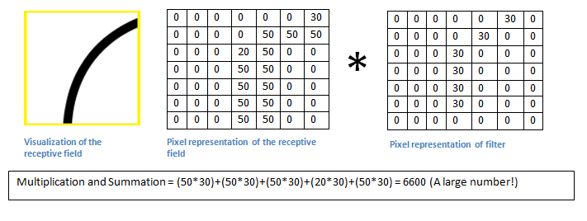
Exercises on CNN
Exercise 1: Convolution (conv) layer How to find the curve feature
We use convolution (see appendix).
The large output after convolution of the images A and B B=flipped feature mask) shows the window has such a curve
Exercise 1: If B=B_{new} , find Multi_and_Sum.
Answer_________?
We can interpret the receptive field (A) as the input image, the flipped filter mask (B) as the weights in a neural network.
=A
=B
=B_{new} (empty cell = 0)
 | 30
 |  | 30
 |  |  | 30
 |  |  | 30
 |  |  | 30
 |  |  | 30
 |  |  | 30
Multi_and_Sum

Slide 22
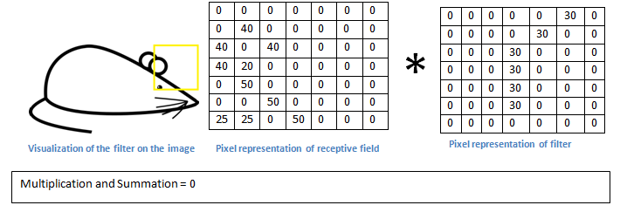
Convolution (conv) layer : In this part of the image, the curve feature is not found (convolution =0), so this window has no such a curve feature

Slide 23
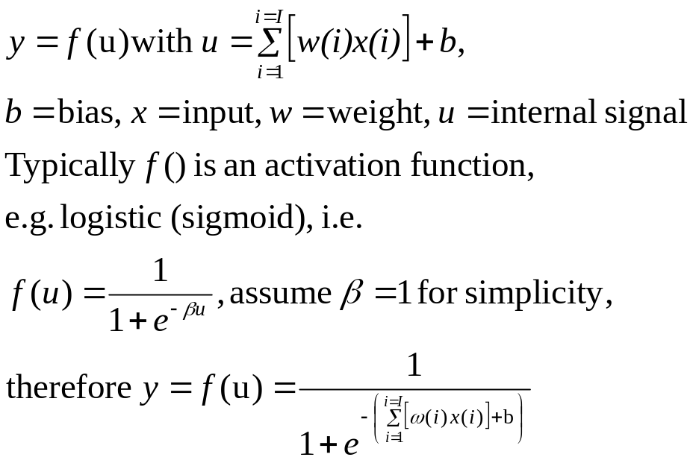





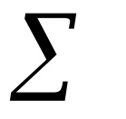
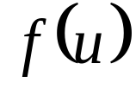



To complete the convolution layer
After convolution (multiplication and summation) the output is passed to a non-linear activation function (Sigmoid or Tanh or Relu), same as Back –Propagation NN

Slide 24
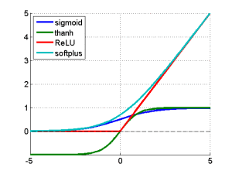
Activation function choices
sigmoid: g(x) = 1 /(1+exp(-x)). The derivative of sigmoid function g'(x) = (1-g(x))g(x).
tanh : g(x) = sinh(x)/cosh(x) = ( exp(x)- exp(-x) ) / ( exp(x) + exp(-x) )
Rectifier: (hard ReLU) is really a max function g(x)=max(0,x)
Softplus: Another version is Noise ReLU max(0, x+N(0, σ(x)). ReLU can be approximated by a so called softplus function (for which the derivative is the logistic functions):
g(x) = log(1+exp(x))
Relu is now very popular and shown to be working better other methods
https://imiloainf.wordpress.com/2013/11/06/rectifier-nonlinearities/

Slide 25
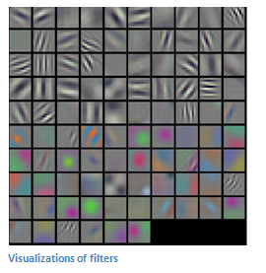
Example (LeNet)
An implementation example http://yann.lecun.com/exdb/lenet/
Input conv. subs. conv subs fully fully output
Each feature filter uses one kernel (e.g. 5x5) to generate a feature map
Each feature map represents the output of a particular feature filter output.
Alternating Convolution (conv) and subsampling layer (subs)
Subsampling allows the features to be flexibly positioned
(array of feature maps

Slide 26
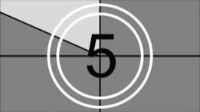
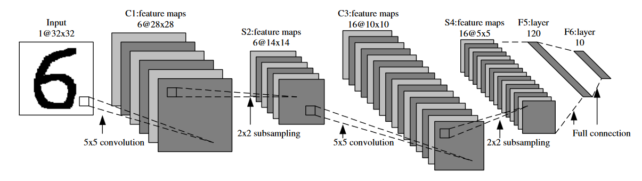

Exercise2 and Demo (click image to see demo)
http://deeplearning.stanford.edu/wiki/images/6/6c/Convolution_schematic.gif , https://link.springer.com/content/pdf/10.1007%2F978-3-642-25191-7.pdf
1 | 0 | 1
0 | 1 | 0
1 | 0 | 1
This is a 3x3 mask for illustration purpose,
but noted that the above application uses a 5x5 mask.
Input image
A different kernel generates a different feature map
A feature map
X
Convolution mask (kernel). It just happens the flipped mask (assume 3x3) = the mask, because it is symmetrical
Y
Exercise 2: (a) Find X,Y. Answer:X=_______? , Y=_______?
(b) Find X again if the convolution mask is [0 2 0;
2 0 2;
0 2 0].
Answer:X_{new}=____?

Slide 27
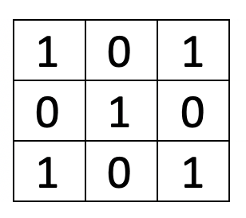
Convoluation

Slide 28
Convoluation
Stride is the size of the step the convolution filter moves each time.

Slide 29

Convoluation
Padding: Feature map is always smaller than the input. Do something to prevent our feature map from shrinking.

Slide 30
Description of the layers
Subsampling
Layer to layer connections

Slide 31
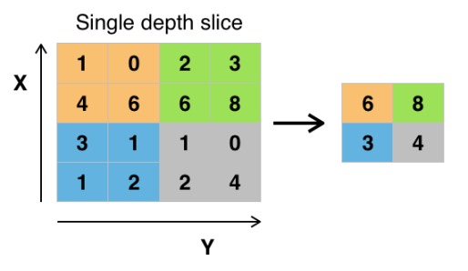
Subsampling (subs)
Subsampling allows the features to be flexibly positioned
  Find an output of a matrix of 2x2
  Sample( ) =s
It may be
  Take average : s=(a+b+c+d)/4, or
  Max pooling : s= max(a,b,c,d)
a | b
c | d
Max pooling
https://en.wikipedia.org/wiki/Convolutional_neural_network#/media/File:Max_pooling.png

Slide 32
Exercise 3: A small example of how the feature map is calculated
Input image 7x7
Kernel 3x3
output feature map 5x5
Convolve
with
If the step size of the convolution is 1 pixel (horizontally and vertically), explain why the above output feature map is 5x5.
If input is 32x32, mask is 5x5, what is the size of the output feature map? Answer: _______
If input is 28x28, what is the size of the subsample layer? Answer:________
If input is 14x14, kernel=5x5, what is the size of the output feature map? Answer:__________
In question(a), if the step size of the convolution is 2 pixels, What is the size of he output feature map. Answer:____________? 3x3

Slide 33
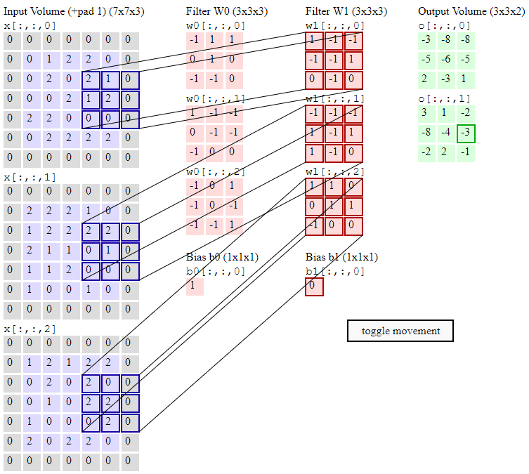

Slide 34
A demo
2*1+1*(-1)+1*-1+2*-1
+
2*-1+2*-1+1*-1
+
2*1+2*1= -3
Input is a 3 7x7 image (e.g. RGB)
Shift step size is 2 pixels rather than 1, therefore the output is 3x3 for each feature map
Generate 2 output feature maps
  0[:,:,0]
  0[:,:,1]
http://cs231n.github.io/convolutional-networks/

Slide 35
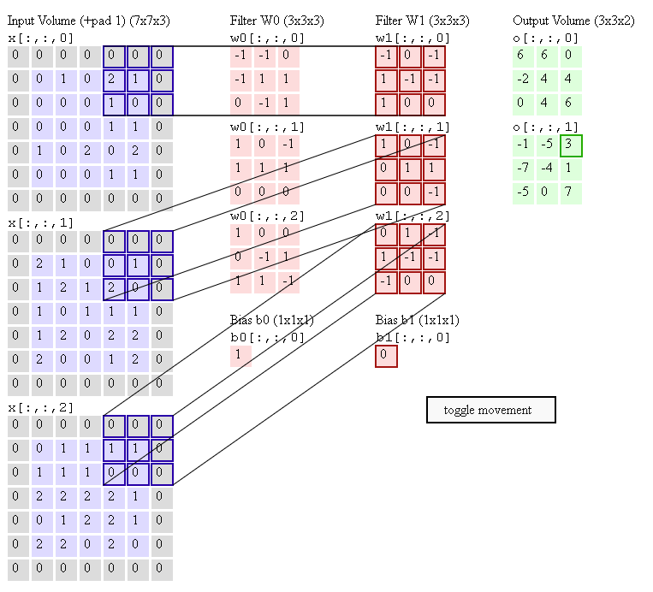
Exercise 4 and another demo
2*1+1*(-1)+1*1+
1*1+
1*1+1*(-1)=3
Input is a 3 7x7 image (e.g. RGB)
Shift step size is 2 pixels rather than 1, therefore the output is 3x3 for each feature map
Generate 2 output feature maps
  0[:,:,0]
  0[:,:,1]
Exercise 4: verify the results in outputs:
  0[:,:,0] and 0[:,:,1]
1*(-1)+
2*1+1*(1)+2*(-1)+
1*(-1)=-1
http://cs231n.github.io/convolutional-networks/

Slide 36
Example
Using a program

Slide 37
Example: Overview of
Test_example_CNN.m
Read data base
Part I:
cnnsetup.m
  Layer 1: input layer (do nothing)
  Layer 2→ convolution(conv.) Layer, output maps=6, kernel size=5x5
  Layer 3→ sub-sample (subs.) Layer, scale=2
  Layer 4→ conv. Layer, output maps =12, kernel size=5x5
  Layer 5→ subs. Layer (output layer), scale =2
Part 2:
cnntrain.m % train weights using 60,000 samples
  cnnff( ) % CNN feed forward
  cnndb( ) % CNN feed back to train weighted in kernels
  cnnapplygrads( ) % update weights
cnntest.m % test the system using 10000 samples and show error rate
Matlab example based on
http://www.mathworks.com/matlabcentral/fileexchange/38310-deep-learning-toolbox

Slide 38
Architecture example
Layer 3→4:
12 conv.
Maps (C)
InputMaps=6
OutputMaps=12
Fan_in=
6x5²=150
Fan_out=
12x5²=300
Layer 1→2:
6 conv.Maps (C)
InputMaps=6
OutputMaps=6
Fan_in=5²=25
Fan_out=6x5²=150
Layer 2→3:
6 sub-sample
Map (S)
InputMaps=6
OutputMaps=12
Layer 4→5:
12 sub-sample
Map (S)
InputMaps=12
OutputMaps=12
Each output neuron corresponds to a character (0,1,2,..,9 etc.)
Layer 1:
One input (I)
Layer 1:
Image
Input
3x28x28
Layer 5
(subsample):
12x4x4
Layer 2
(hidden):
6x24x24
Layer 3
(subsample):
6x12x12
Layer 4
(hidden):
12x8x8
10
outputs
Conv.
Kernel
=5x5
Subs
Kernel
=5x5
Conv.
2x2
Subs
I=input
C=Conv.=convolution
S=Subs=sub sampling or mean or max pooling
2x2

Slide 39
Data used in training of a neural networks
  Training set
    Around ≈ 60-70 % of the total data
    Used to train the system
  Validation set (optional)
    Around ≈ 10-20 % of the total data
    Used to tune the parameters of the model of the system
  Test set
    Around ≈ 10-20 % of the total data
    Used to test the system
  Data in the above sets cannot be overlapped, the exact % depends on applications and your choice.

Slide 40
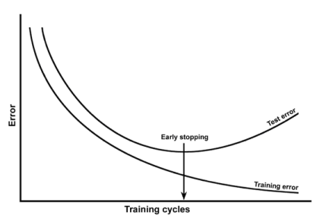
Warning: How to train a neural network to avoid data over fitting
Over-fitting: the system works well for training data but not testing data, so extensive training may not help.
What should we do: Use validation data to tune the system to reduce the test error at early stop.
Error from loss function
Test error curve using testing data
Early stopping
test error at early stop
Training cycles (epoch)
Training error using training data
https://stats.stackexchange.com/questions/131233/neural-network-over-fitting

Slide 41
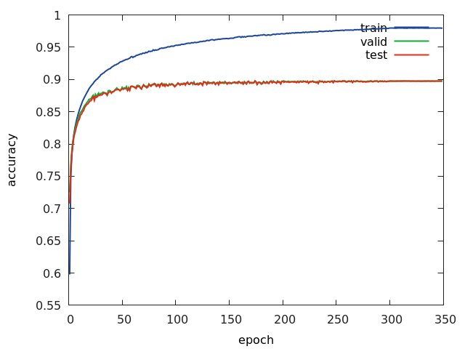
Same idea from the view point of accuracy
https://www.researchgate.net/publication/313508637_Detection_and_characterization_of_Coordinate_Measuring_Ma-_chine_CMM_probes_using_deep_networks_for_improved_quality_assurance_of_machine_parts/figures?lo=1
By https://www.researchgate.net/profile/Binu_Nair

Slide 42
Part A
Feed forward part of
cnnff( )
Matlab example
http://www.mathworks.com/matlabcentral/fileexchange/38310-deep-learning-toolbox

Slide 43
Cnnff.m
Convolution Neural Networks feed forward
This is the feed forward part
Assume all the weights are initialized or calculated, we show how to get the output from inputs.
  Ref: CNN Matlab example http://www.mathworks.com/matlabcentral/fileexchange/38310-deep-learning-toolbox

Slide 44
Layer 1→2
(Input to hidden):
Convolute layer 1 with different kernels (map_index1=1,2,.,6) and produce 6 output maps
Inputs :
    input layer 1, a 28x28 image
    6 different kernels : k(1),.,,,k(6) , each k is 5x5, K are dendrites of neurons
Output : 6 output maps each 24x24
Algorithm
For(map_index=1:6)
{
layer_2(map_index)=
I*k(map_index)_{valid}
}
Discussion
“Valid” means only consider overlapped areas, so if layer 1 is 28x28, kernel is 5x5 each, each output map is 24x24
In Matlab > use convn(I,k,’valid’)
Example:
I=rand(28,28)
k=rand(5,5)
size(convn(I,k,’valid’))
> ans
> 24 24
Layer 1:
One input (I)
Layer 1→2:
6 conv.Maps (C)
InputMaps=6
OutputMaps=6
Fan_in=5²=25
Fan_out=6x5²=150
Layer 1:
Image
Input (i)
3x28x28
Layer 2(c):
6x24x24
Map_index=
1
2
:
6
i
Conv.*K(1)
Kernel
=5x5
Conv.*K(6)
j
2x2
I=input
C=Conv.=convolution
S=Subs=sub sampling

Slide 45
Layer 2→3:
(hidden to subsample)
Sub-sample layer 2 to layer 3
Inputs :
    6 maps of layer 2, each is 24x24
Output : 6 maps of layer 3, each is 12 x12
Algorithm
For(map_index=1:6)
{
For each input map, calculate the average of 2x2 pixels and the result is saved in output maps.
Hence resolution is reduced from 24x24 to 12x12
}
Discussion
Layer 2→3:
6 sub-sample
Map (S)
InputMaps=6
OutputMaps=12
Layer 2 (c):
6x24x24
Layer 3 (s):
6x12x12
Map_index=
1
2
:
6
Subs
2x2

Slide 46
Layer 3→4:
(subsample to hidden)
Conv. layer 3 with kernels to produce layer 4
Inputs :
    6 maps of layer3(L3{i=1:6}), each is 12x12
    Kernel set: totally 6x12 kernels, each is 5x5,i.e.
    K{i=1:6}{j=1:12}, each K{i}{j} is 5x5
    12 bias{j=1:12} in this layer, each is a scalar
Output : 12 maps of layer4(L4{j=1:12}), each is 8x8
Algorithm
for(j=1:12)
{ for (i=1:6)
{clear z, i.e. z=0;
z=z+covn (L3{i}, k{i}{j},’valid’)] %z is 8x8
}
L4{j}=sigm(z+bais{j}) %L4{j} is 8x8
}
function X = sigm(P)
X = 1./(1+exp(-P));
End
Layer 3→4:
12 conv.
Maps (C)
InputMaps=6
OutputMaps=12
Fan_in=
6x5²=150
Fan_out=
12x5²=300
Layer3 L3(s):
6x12x12
Layer 4(c):
12x8x8
net.layers{l}.a{j}
Index=i=1:6
Index=j=1:12
:
Kernel
=5x5
Feature maps in the previous layer can be combined to become feature maps in next layer

Slide 47
Layer 4→5
(hidden to subsample)
Subsample layer 4 to layer 5
Inputs :
    12 maps of layer4(L4{i=1:12}), each is 12x8x8
Output : 12 maps of layer5(L5{j=1:12}), each is 4x4
Algorithm
Sub sample each 2x2 pixel window in L4 to a pixel in L5
Layer 4→5:
12 sub-sample
Map (S)
InputMaps=12
OutputMaps=12
Layer 4:
12x8x8
Layer 5:
12x4x4
Subs
2x2
10

Slide 48
Layer 5→output:
(subsample to output)
Subsample layer 4 to layer 5
Inputs :
    12 maps of layer5(L5{i=1:12}), each is 4x4, so L5 has 192 pixels in total
    Output layer weights: Net.ffW{m=1:10}{p=1:192}, total number of weights is 192
Output : 10 output neurons (net.o{m=1:10})
Algorithm
For m=1:10%each output neuron
{clear net.fv
net.fv=Net.ffW{m}{all 192 weight}.*L5(all corresponding 192 pixels)
net.o{m}=sign(net.fv + bias)
}
Discussion
Layer 4→5:
12 sub-sample
Map (S)
InputMaps=12
OutputMaps=12
Totally
192 weights for each output neuron
Each output neuron corresponds to a character (0,1,2,..,9 etc.)
net.o{m=1:10}
Layer 5 (L5{j=1:12}:
12x4x4=192
Totally 192 pixels
:
:
Same for each output neuron
10

Slide 49
Part B
Back propagation part
cnnbp( )
cnnapplyweight( )

Slide 50
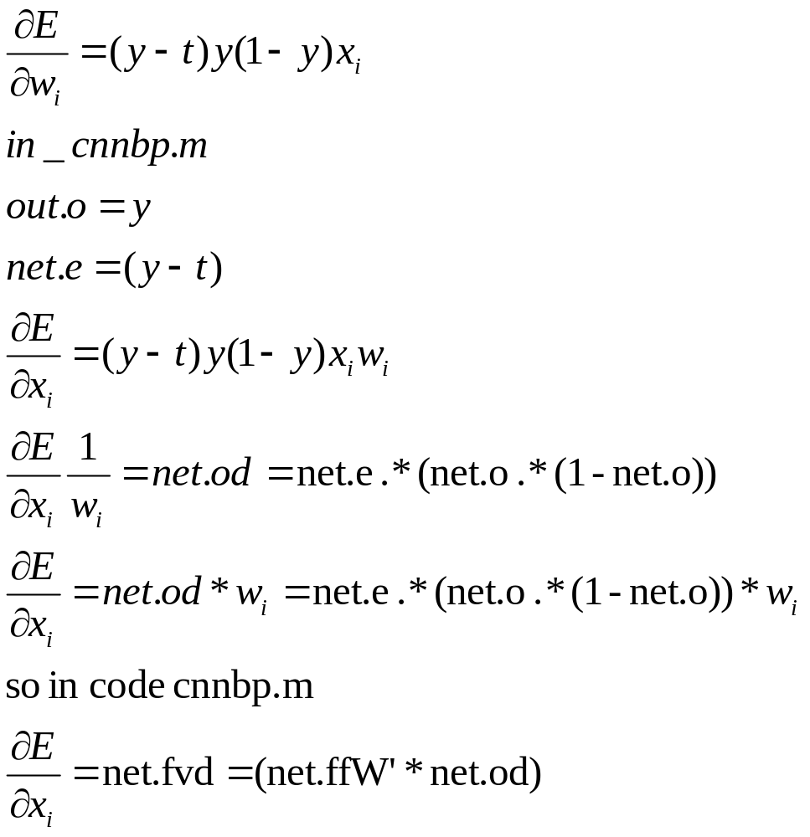
cnnbp( ) overview (output back to layer 5)
Ref: See http://en.wikipedia.org/wiki/Backpropagation

Slide 51
Calculate gradient
From later 2 to layer 3
From later 3 to layer 4
Net.ffW
Net.ffb found
The method is similar to a typical Back propagation neural network BPNN

Slide 52
Details of calc gradients
% part % reshape feature vector deltas into output map style
L4(c) run expand only
L3(s) run conv (rot180, fill), found d
L2(c) run expand only
%Part %% calc gradients
L2(c) run conv (valid), found dk and db
L3(s) not run here
L4(c) run conv(valid), found dk and db
Done , found these for the output layer L5:
  net.dffW = net.od * (net.fv)' / size(net.od, 2);
  net.dffb = mean(net.od, 2);

Slide 53
cnnapplygrads(net, opts)
For the convolution layers, L2, L4
  From k and dk find new k (weights)
  From b and db find new b (bias)
For the output layer L5
  net.ffW = net.ffW - opts.alpha * net.dffW;
  net.ffb = net.ffb - opts.alpha * net.dffb;
  opts.alpha is to adjust learning rate

Slide 54
Summary
Studied the basic operation of Convolutional Neural networks (CNN)
Demonstrate how a simple CNN can be implemented

Slide 55
References
Wiki
  http://en.wikipedia.org/wiki/Convolutional_neural_network
  http://en.wikipedia.org/wiki/Backpropagation
Matlab programs
  Neural Network for pattern recognition- Tutorial http://www.mathworks.com/matlabcentral/fileexchange/19997-neural-network-for-pattern-recognition-tutorial
  CNN Matlab example http://www.mathworks.com/matlabcentral/fileexchange/38310-deep-learning-toolbox
CNN tutorial
  http://cogprints.org/5869/1/cnn_tutorial.pdf

Slide 56
Appendix

Slide 57
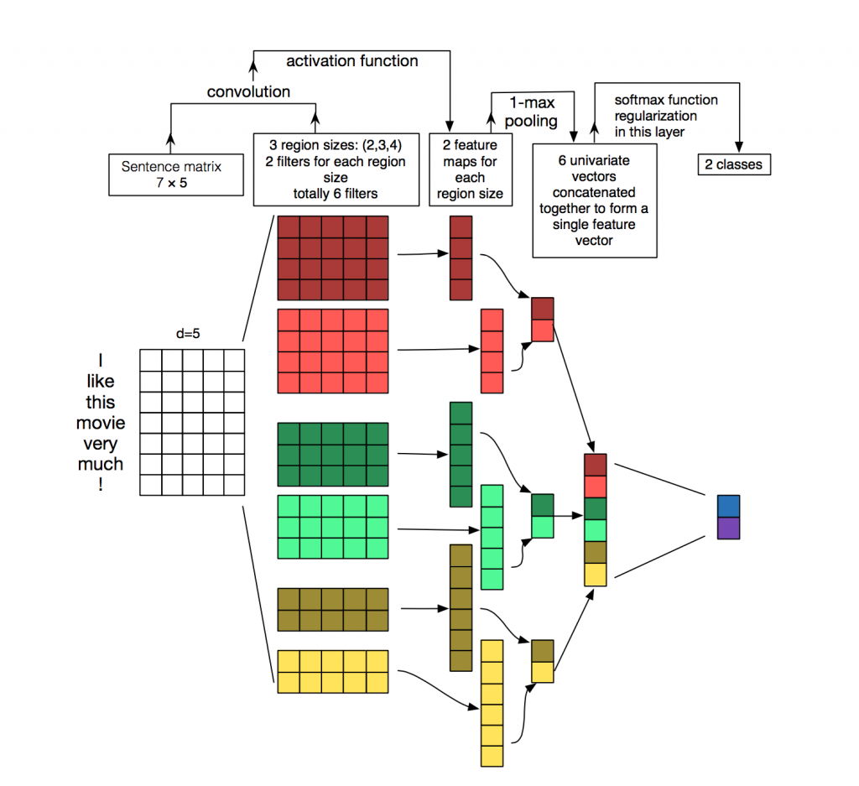
Another connection example for CNN
Some systems can use different arrangements for connecting 2 neighboring layers
http://www.wildml.com/2015/11/understanding-convolutional-neural-networks-for-nlp/

Slide 58
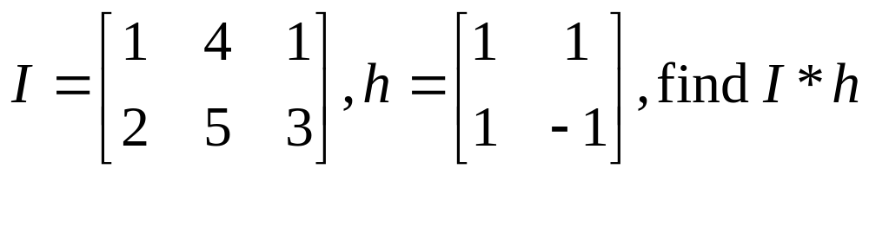
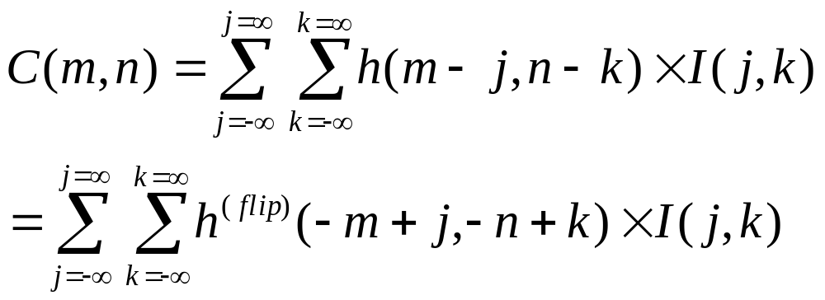
Discrete convolution: Correlation is more intuitive
so we use correlation of the flipped version of h to implement convolution[1]
convolution
Flipped h
correlation

Slide 59
Matlab (octave) code for convolution
I=[1 4 1;
2 5 3]
h=[1 1 ;
1 -1]
conv2(I,h)
pause
disp('It is the same as the following');
conv2(h,I)
pause
disp('It is the same as the following');
xcorr2(I,fliplr(flipud(h)))

Slide 60
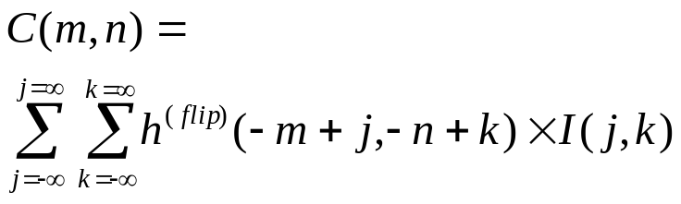
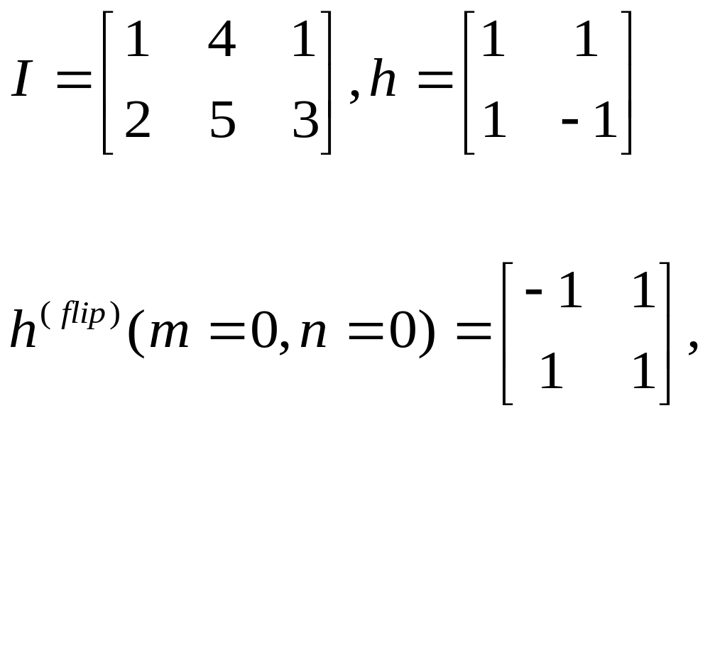
Correlation is more intuitive, so we use correlation to implement convolution.
k
k
k=1
k=0
j=0 1 2
j
j=0 1
j
Flip h
k
j=0 1
j
Discrete convolution I*h, flip h ,shift h and correlate with I [1]

Slide 61
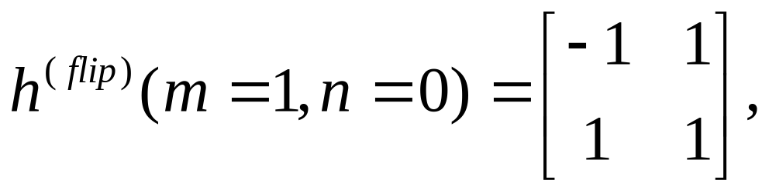
Discrete convolution I*h, flip h ,shift h and correlate with I [1]
k
k
n
j
j
j=0 1
C(m,n)
Flip h: is like this after the flip
and no shift (m=0,n=0)
k
m
The trick: I(j=0,k=0) needs to multiply to h^{(flip)}(-m+0,-n+0), since m=1, n=0, so we shift the h^{(flip)} pattern 1-bit to the right so we just multiply overlapped elements of I and h^{(flip)}. Similarly, we do the same for all m,n values
j
Shift Flipped h to m=1,n=0
k
j

Slide 62
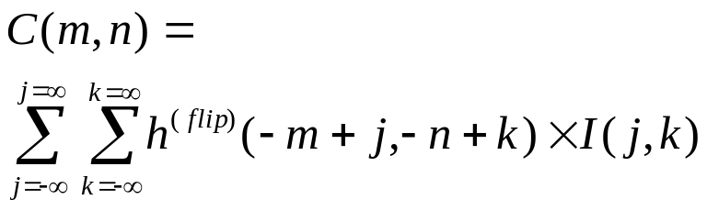
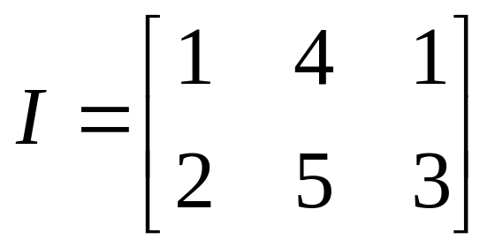
Find C(m,n)
Shift Flipped h to m=1,n=0
K
K
J
J
multiply overlapped elements
and add (see next slide)

Slide 63
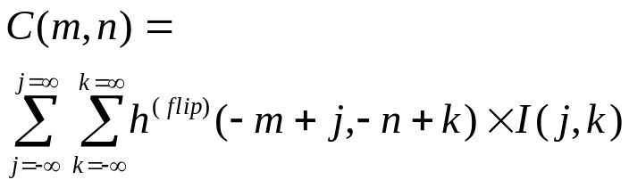
Find C(m,n)
Shift Flipped h to m=1,n=0
K
K
n
C(m,n)
J
J
m
multiply overlapped elements
and add

Slide 64
Steps to find C(m,n)
Step1:
C(0,0)
=1x2=2
Step 2:
C(1,0)
= -1*2+1*5=3
Step 3:
C(2,0)
= -1*5+1*3
=-2
Step 4:
C(3,0)
= -1*3
=-3
1 | 4 | 1
2 | 5 | 3
1 | 4 | 1
2 | 5 | 3
-1 | 1
1 | 1
-1 | 1
1 | 1
1 | 4 | 1
2 | 5 | 3
1 | 4 | 1
2 | 5 | 3
-1 | 1
1 | 1
-1 | 1
1 | 1
C(0,0) | C(1,0) | C(2,0) | C(3,0)
C(0,0) | C(1,0) | C(2,0) | C(3,0)
C(0,0)=2 | C(1,0)=3 | C(2,0)=-2 | C(3,0)=-3
C(m,n)=

Slide 65
Steps continue
1 | 4 | 1
2 | 5 | 3
Step 5:
C(0,1)
=1x1+1*2
=3
Step 6:
C(1,1)
= -1*1+1*4+1*2+1*5
=10
Step 7:
C(2,1)
= -1*4+1*1+1*5+1*3
=5
Step 8:
C(3,1)
= -1*1+1*3
=2
1 | 4 | 1
2 | 5 | 3
-1 | 1
1 | 1
-1 | 1
1 | 1
1 | 4 | 1
2 | 5 | 3
-1 | 1
1 | 1
1 | 4 | 1
2 | 5 | 3
-1 | 1
1 | 1
C(0,2) | C(1,2) | C(2,2) | C(3,2)
C(0,1)=3 | C(1,1)=10 | C(2,1)=5 | C(3,1)=2
C(0,0)=2 | C(1,0)=3 | C(2,0)=-2 | C(3,0)=-3
C(m,n)=

Slide 66
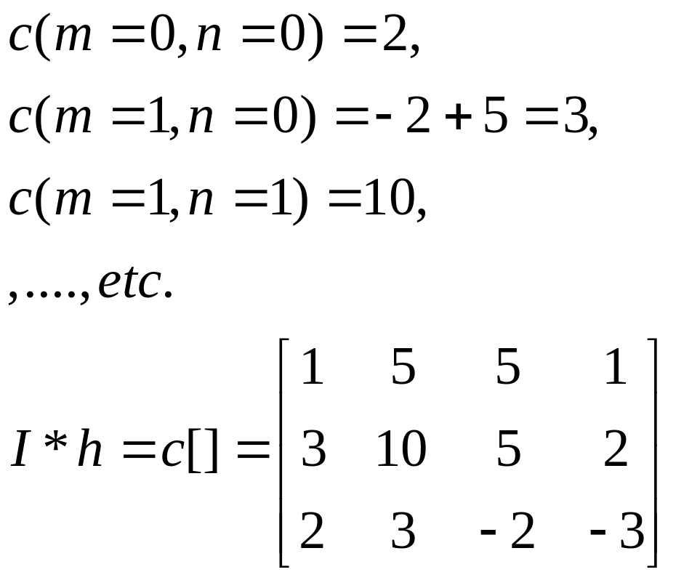
Find all elements in C for all possible m,n
n
C(m,n)
n
m
m

Slide 67
Exercise
I=[1 4 1;
2 5 3
3 5 1]
h2=[-1 1
1 -1]
Find convolution of I and h2.

Slide 68
Answer
%ws3.1 edge
I=[1 4 1;
2 5 3
3 5 1]
h2=[-1 1
1 -1]
%Find convolution of I and h2.
conv2(I,h2)
%
% ans =
%
% -1 -3 3 1
% -1 0 -1 2
% -1 1 2 -2
% 3 2 -4 -1

Slide 69
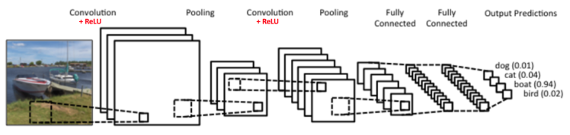
Relu (Rectified Linear Unit) layer
(To replace Sigmoid or tanh function)
Some CNN has a Relu layer
If f(x) is the layer input , Relu[f(x)]=max(f(x),0)
It replaces all negative pixel values in the feature map by zero.
It can be used to replace Sigmoid or tanh.
The performance is shown to be better Sigmoid or tanh.
https://ujjwalkarn.me/2016/08/11/intuitive-explanation-convnets/

Slide 70
Answer :Exercises on CNN
Exercise 1: Convolution (conv) layer How to find the curve feature
We use convolution (see appendix).
The large output after convolution of the images A and B B=flipped feature mask) shows the window has such a curve
Exercise 1: If B=B_{new} , find Multi_and_Sum.
Answer_________?=30*50+30*50+30*50+20*30+50*30
We can interpret the receptive field (A) as the input image, the flipped filter mask (B) as the weights in a neural network.
=A
=B
=B_{new} (empty cell = 0)
 | 30
 |  | 30
 |  |  | 30
 |  |  | 30
 |  |  | 30
 |  |  | 30
 |  |  | 30
Multi_and_Sum

Slide 71
Answer2: and Demo (click image to see demo)
http://deeplearning.stanford.edu/wiki/images/6/6c/Convolution_schematic.gif , https://link.springer.com/content/pdf/10.1007%2F978-3-642-25191-7.pdf
1 | 0 | 1
0 | 1 | 0
1 | 0 | 1
This is a 3x3 mask for illustration purpose,
but noted that the above application uses a 5x5 mask.
Input image
A different kernel generates a different feature map
A feature map
X
Convolution mask (kernel). It just happens the flipped mask (assume 3x3) = the mask, because it is symmetrical
Y
Exercise 2: (a) Find X,Y. Answer:X=____4 , Y=______3
(b) Find X again if the convolution mask is [0 2 0;
2 0 2;
0 2 0].
Answer:X_{new}=2*1+2*1+2*1=6

Slide 72
Answer 3: A small example of how the feature map is calculated
Input image 7x7
Kernel 3x3
output feature map 5x5
Convolve
with
If the step size of the convolution is 1 pixel (horizontally and vertically), explain why the above output feature map is 5x5.
If input is 32x32, mask is 5x5, what is the size of the output feature map? Answer: _______28x28
If input is 28x28, what is the size of the subsample layer? Answer:________14x14
If input is 14x14, kernel=5x5, what is the size of the output feature map? Answer:__________ 10x10
In question(a), if the step size of the convolution is 2 pixels, What is the size of he output feature map. Answer:____________? 3x3 3x3

